Slide 1
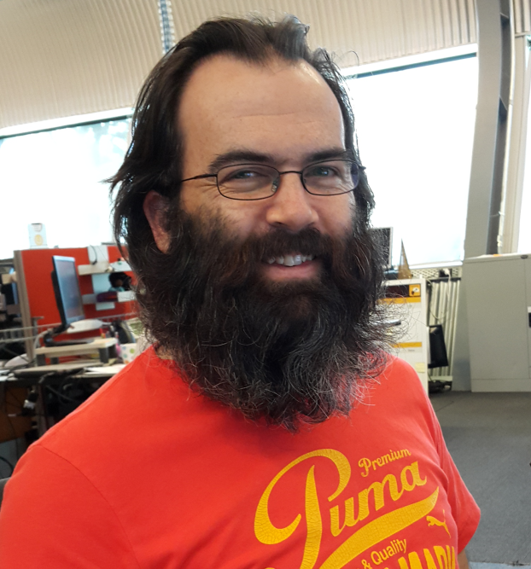
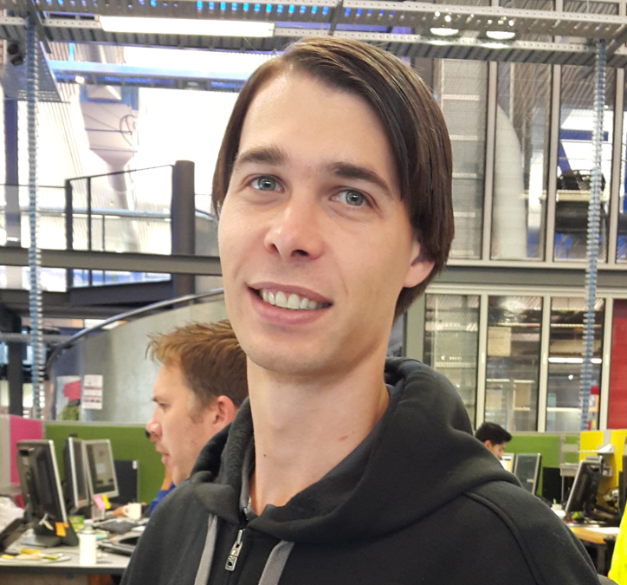
Platform Team
Paul Palmer
Ben Hugo

Slide 2
Atlas Platform
Container
5
1
2
IAM
Platform Services
Feature 1
Feature 2
3
Transactions
Payments
Product-Requests
Accounts
Transfers
Products
…
Feature 3
Layer 7 (APIs)
4
Middleware
HOST
Onyx

Slide 3
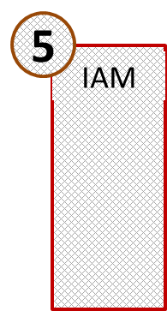
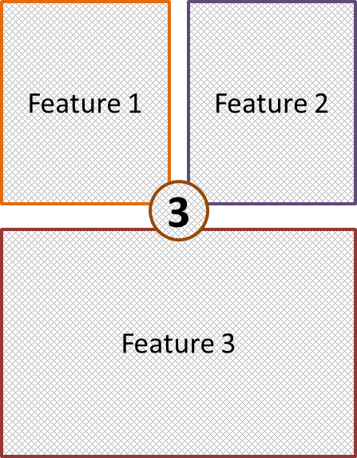
Platform Services
Container
1
2
Platform Services
Transactions
Payments
Product-Requests
Accounts
Transfers
Products
…
Layer 7 (APIs)
4
Middleware
HOST
Onyx

Slide 4
Platform Services
1
Themes
Configuration
Tokens
Container Settings

Slide 5
Platform Services
Configuration
Themes
2
Tokens
Container Settings

Slide 6
Platform Services
Configuration
Themes
3
Tokens
Container Settings

Slide 7
Platform Services
4
Configuration
Themes
Tokens
Container Settings

Slide 8
Microservice Framework
Microservice
(Nuget Package)
Generic CRUD
Authentication Modules
?
Generic CRUD
Logging

Slide 9
Existing Microservices
Platform Services
Enterprise Microservice
Logging Microservice
Auditing Microservice

Slide 10
Microsoft Release Management
Development
Testing
Production
1
2
3
One Click Deployment

Slide 11

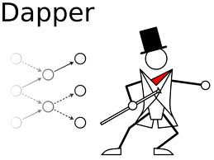
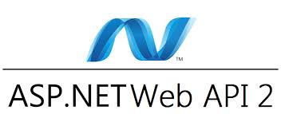



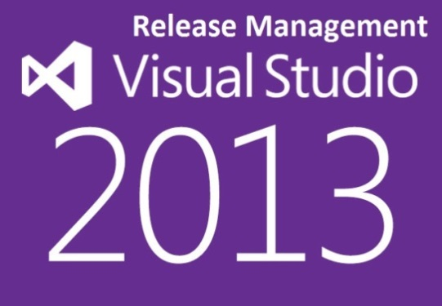
Technology Stack

Slide 12
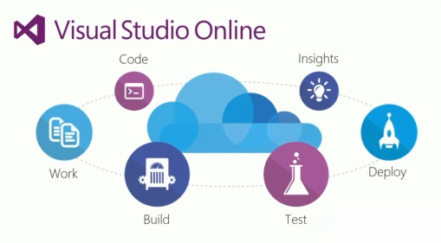
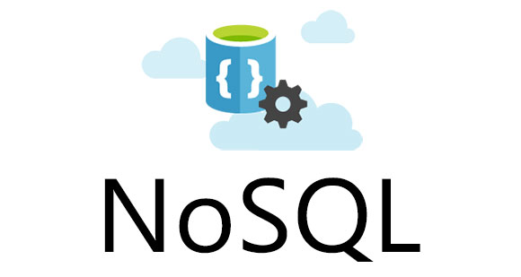
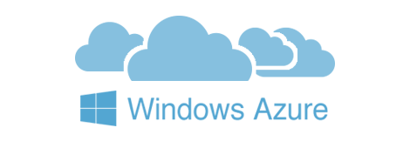
What next?

